Slide 1
Database Design Fundamentals
DV6E 34

Slide 2
Topics/Outline
Database – Definition, Types, Terminologies, concepts, classes & examples
Flat Files
Relational Database Management System (RDBMS)
E-R Model Systems
Normalisation
SQL – Introduction, queries,
Creating Database (simple - excel & structured - RDMS)
Basic Operations (DB interrogation, data acquisition, modification, normalisation, manipulation….)

Slide 3
Part. D: Flat Files

Slide 4
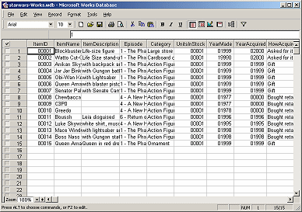
Flat Files
Flat file database organises data into a single table which can be used for various simple applications.
A flat file may contain many fields, often with duplicate data
Relational databases contain keys (primary and foreign) which are used to relate different tables, Flat files use an index (automatically generated) to reference fields in the database.
An index is usually an auto-generated number that identifies the record number in the table, usually starting at 1
Index helps searching and organization of tables

Slide 5



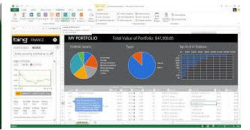
Flat Files - Examples
Excel spreadsheet (*.xlx)
Word document (*.csv)
Microsoft Access (*.mdb)

Slide 6
Uses of Flat Files
Flat files are useful for:
Lists of contact names and addresses
Lists of student grades
Details of a video collection
Note:
Data stored in one flat file cannot easily be linked to data stored in another flat file.

Slide 7
Benefits of using Flat Files
Flat files are familiar and conceptually easy to use
Flat files are portable and readable by most statistical and graphical software
No additional software layer is required to learn before working with flat files.
Generally, simple to use
They are inexpensive

Slide 8
Problems with Using Flat Files
Data repetition/redundancy
Data dependence
Incompatibility of files
Separation and isolation
Large computer memory usage
Importing/exporting of data in flat files from one application to another can compromise the integrity of the data.
Note
Data Redundancy refers to the unnecessary duplication of data within a database.

Slide 9
Why Relational Databases (RDBMS) are used instead of Flat Files
Extensive self-documentation via lookup tables
Data integrity checks:
Easy to share portions of data without extensive programming
Easy to use in a web environment
DB are can handle much larger data sizes compared to handling in flat file format
DB allows multiple relations to be linked easily and operations to be performed more efficiently and quickly.

Slide 10
Fixing Flat Files Problems
Avoiding data entry repetition
Moving and separating data into different tables i.e. using multiple tables
Example:
- Which data do you think could be moved to separate tables?
Student ID | Student forename | Student surname | Date enrolled | Course code
1 | Philip | Harris | 30/08/2002 | 119
2 | Michael | Jenner | 09/09/2002 | 115
3 | Ian | Bemrose | 07/09/2002 | 119
4 | Meena | Akbar | 12/09/2002 | 118
5 | James | Payne | 09/09/2002 | 115
6 | Campbell | Naeve | 12/10/2002 | 114

Slide 11
Fixing Flat Files Problems - Example
The course data (Course Code) could be moved into a separate table as follows
Course Code | Course title
114 | Physics
115 | Chemistry
118 | Applied Science
119 | Chemistry
You will be able to search the DB using the Course Code to find out each courses
offered and also the list of students taking those courses…

Slide 12
Fixing Flat Files Problems - Example
The subject information (Subject ID) could be moved into a separate table as follows
Subject ID | Subject Name | Day | Period | Lecturer ID
14 | Physiology | Tuesday | 3 | 1
15 | Atoms | Tuesday | 5 | 2
16 | Electrons | Monday | 4 | 3
17 | Particles | Wednesday | 3 | 4

Slide 13
Fixing Flat Files Problems
The lecturer information (Lecturer ID) could be moved into a separate table as follows:
Lecturer ID | Lecturer Name | Date Employed
1 | Meaner | 03/11/1995
2 | Maynard | 01/02/2002
3 | Noakes | 09/10/1999
4 | Smith | 14/12/2002
A unique ID has been assigned to each lecturer, since if two people were hired with the same name, it would be difficult to distinguish between them.

Slide 14
Fixing Flat Files Problems
Note that the initial setup does not allow students to take more than one subject, based on the flat file structure
In order to allow that, another table will be required.
Student ID | Student forename | Student surname | Date enrolled | Course code
1 | Philip | Harris | 30/08/2002 | 119
2 | Michael | Jenner | 09/09/2002 | 115
3 | Ian | Bemrose | 07/09/2002 | 119
4 | Meena | Akbar | 12/09/2002 | 118
5 | James | Payne | 09/09/2002 | 115
6 | Campbell | Naeve | 12/10/2002 | 114
The information of the subjects taken by each students in the DB initially setup
appeared to be missing, hence another table will be required to show that …

Slide 15
Fixing Flat Files Problems
The new table below shows the each Student’s ID and the different subjects taken using the Subject ID.
Student_SubjectID | Student ID | Subject ID
001 | 1 | 14
002 | 1 | 15
003 | 2 | 14
004 | 3 | 14
005 | 3 | 16
006 | 4 | 15
007 | 4 | 16
Flat File Problem - Fixed
Redundant data has been reduced.
Risk of errors reduced
Modifying and updating data problems resolved

